Slide 1

September 28 - 29, 2022
Orlando, Florida
Notes:
Maybe merge slide 1 and 2 / usually the one with your names and title is the Main ☺

Slide 2
Session #1367
The Dev, the Ops and Git
How fast can they recover a disaster?
Fabrice Pipart | Senior Technical Expert | Amadeus IT
James Searby | Principal Engineer | Amadeus IT
Notes:
I found your names were kind of lost in the slide, I just centered
The usage of different type of fonts should be sticked for the whole pres.
Added a light gray to give a smooth touch and contrast

Slide 3

5’
Introduction
Who are we?
We’ll keep it short don’t worry
We know we’re not the reason of your presence

Slide 4








Who are we?
@FabricePipart
@jsearby06
echo $(whoami)
JAMES
FABRICE
?
?
Notes:
Recos:
Quite a lot of colors on this one, + the layout : so maybe reduce layout and replace the orange by the Amadeus blue?
Texts horizontals , specially for your introduction – people should be able to read without breaking their neck – is it in purpose the italic and not italic?
You are using quite visible lines in the objects, some suggestions:
Remove the line in the box , make a little bit ticker the line of your photos

Slide 5
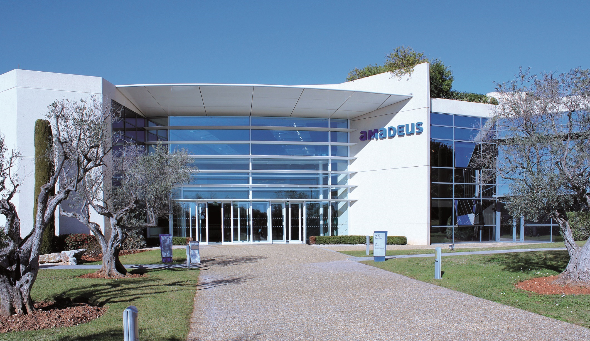

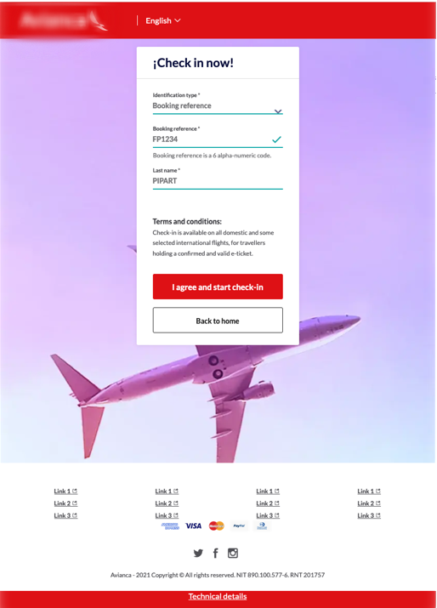

Amadeus
What we do
We provide solutions
for the Travel Industry
When will you fly back ?
Here is my check-in for my flights back home
You certainly have the same
Notes:
Manage the transition to minimize the click
Quite a lot of colors
Suggestion to homogenize that orange,blue and purple
Maybe on those slides having Amadeus layout, you can remove the colorful mountains?
And if we see Amadeus on the layout, having the icon is still needed?

Slide 6






Amadeus in a few words
Some numbers
190+
countries
More than
474
150+
1M+
16,000
690+ million
Total bookings processed in 2020
60+
airlines
hotel properties
nationalities
people worldwide
travel agencies, tour operators and corporations worldwide
languages
Notes:
Manage the transition to minimize the click, to trigger the first batch could help you avoid the empty box for few secs
Maybe on those slides having Amadeus layout, you can remove the colorful mountains?
And if we see Amadeus on the layout, having the icon is still needed?

Slide 7

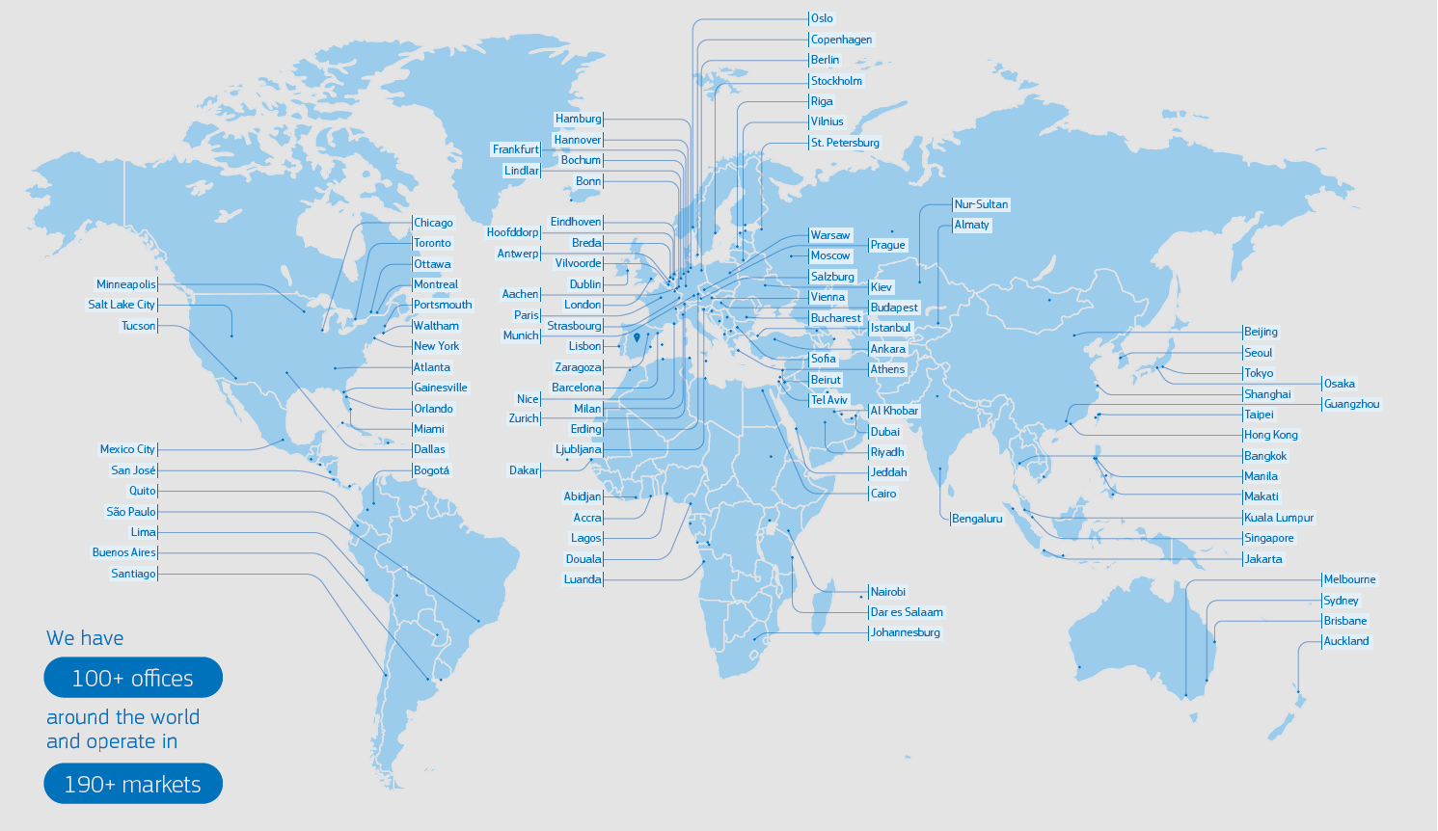

Amadeus world presence
World’s largest data processing center dedicated to the travel industry
A multicultural company
More than
16,000
people worldwide
190+
countries
150+
60+
nationalities
languages

Slide 8





Amadeus Digital
Large scale frontend deployments
Dozens of webapps
2000+ hits / sec
Millions lines of code
SOAP
Java
REST
www
Angular
Helm
K8s / OpenShift
Open Source
Private Cloud
Public Cloud
Notes:
Manage the transition to minimize the click – images can enter with previous.. It will be more natural
Quite heavy with the mountains layout

Slide 9

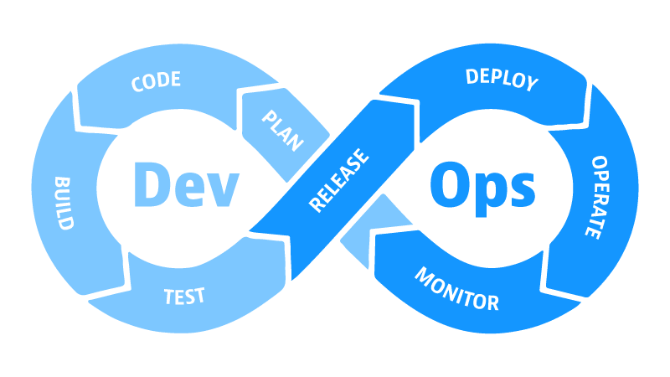
Amadeus experience
2022
We lived several technical revolutions
2015
Kubernetes
2013
Docker
1998 google
2011
IaaS
1995 java
2001 first phone with internet
What now ?
1994 1st cookie
1990 www
2016 - 2020
Migration to private Cloud
2001 Online flight booking
2006 - 2017
Leave mainframes
1987
1998 Amadeus GDS
creation
Notes:
Manage the transition to minimize the click – the beginning of the road can be triggered without clicking
Careful with colors too and vote to try without mountains layout

Slide 10
GitOps ?
Isn’t git for developers?
Notes:
Not fan of title :D

Slide 11



The Ops, the Dev and Git
Notes:
Perso, I am not fan of italic font ☺ worth to try to give a little bit of softness to the purple
Up to you

Slide 12









It always starts with a dream …
Notes:
I will go with a lighter purple – giving you an example and not sure if mountains layout is fitting too.. See slide 65
Have doubts on the icon with the could and the moto.. Maybe with the context I will get it
No animation?

Slide 13

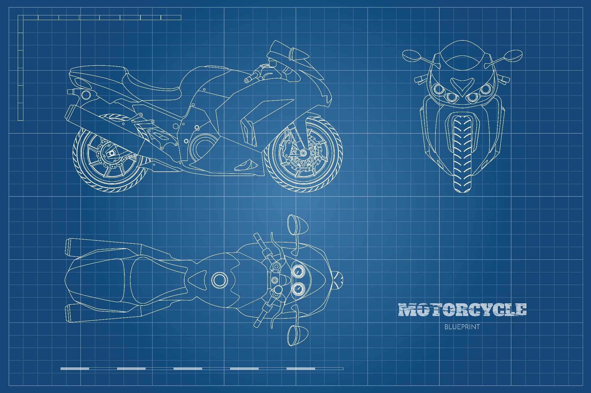
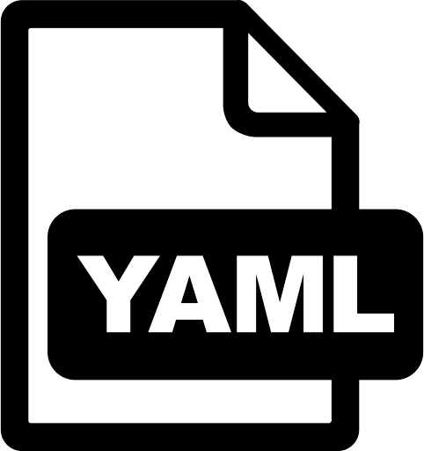
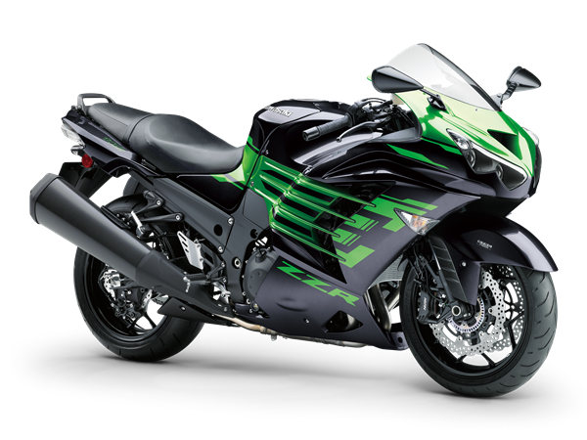
Make a plan

Slide 14
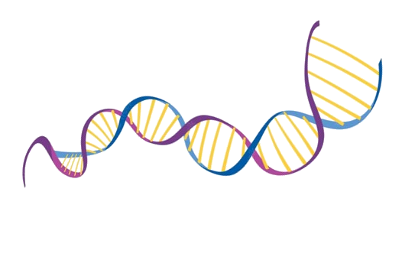

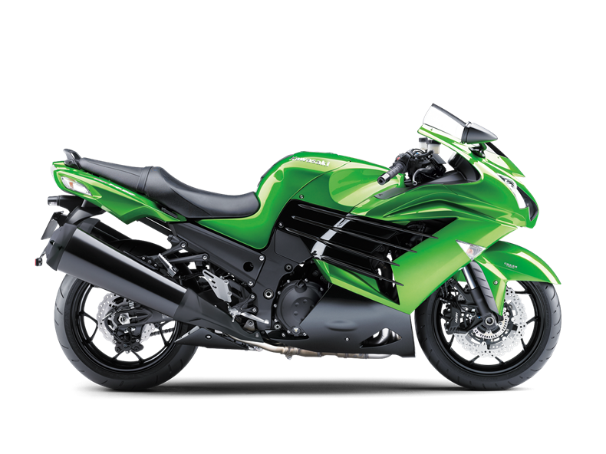
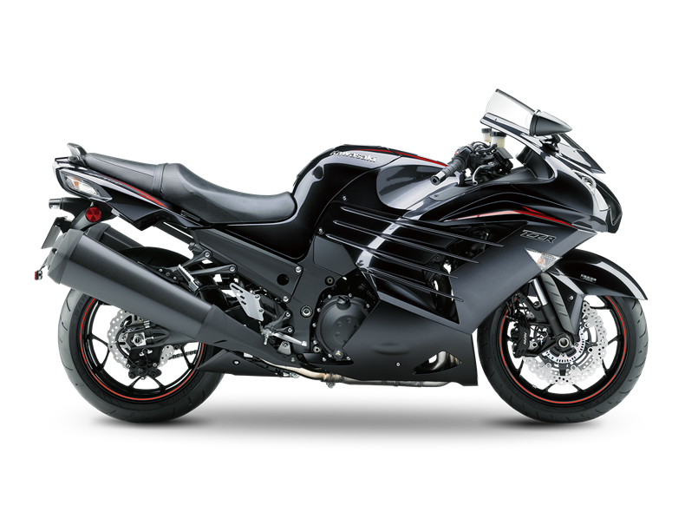
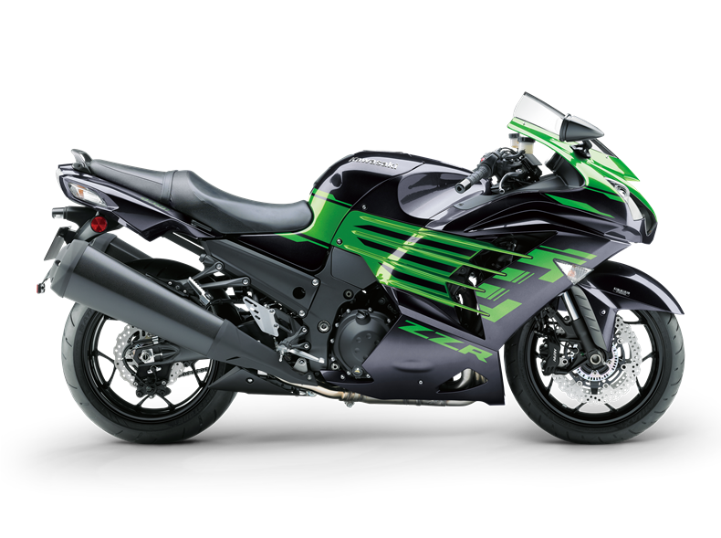
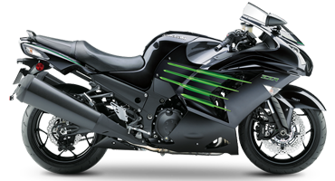

Describe every aspect and sign the contract
Notes:
The color change on the moto is an easter egg?
It makes sense to syn your animation with the git and YAML icons?

Slide 15
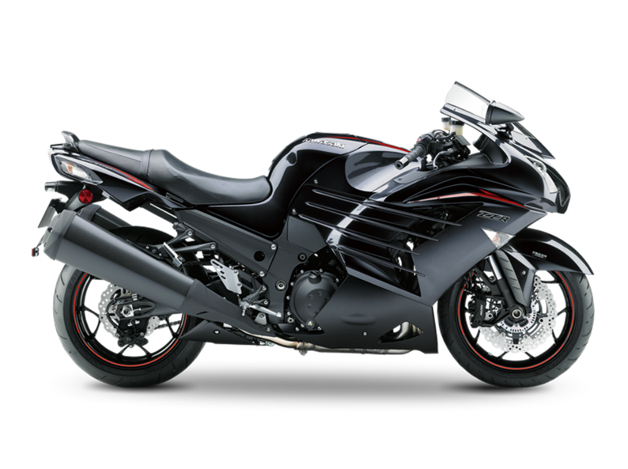
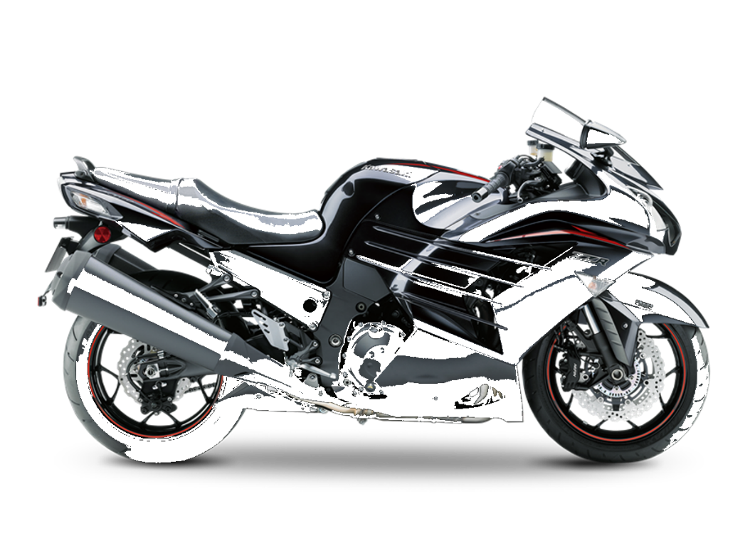
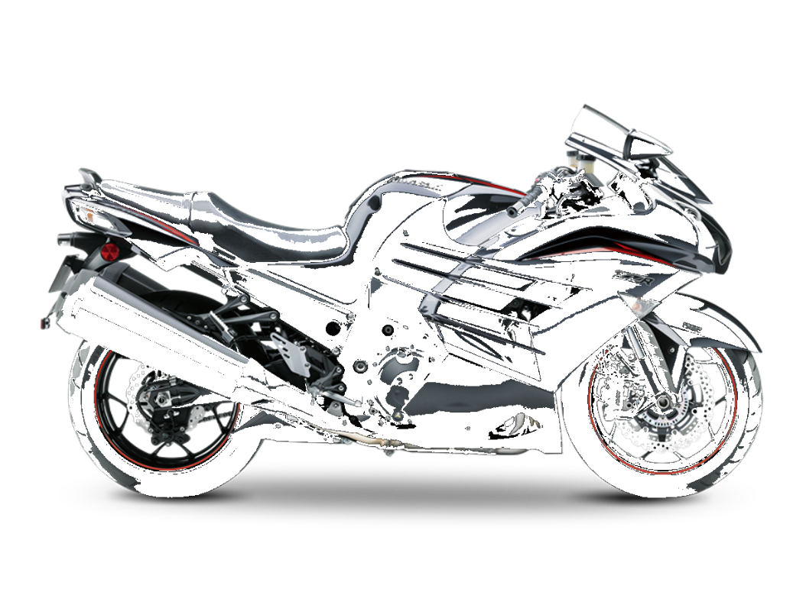
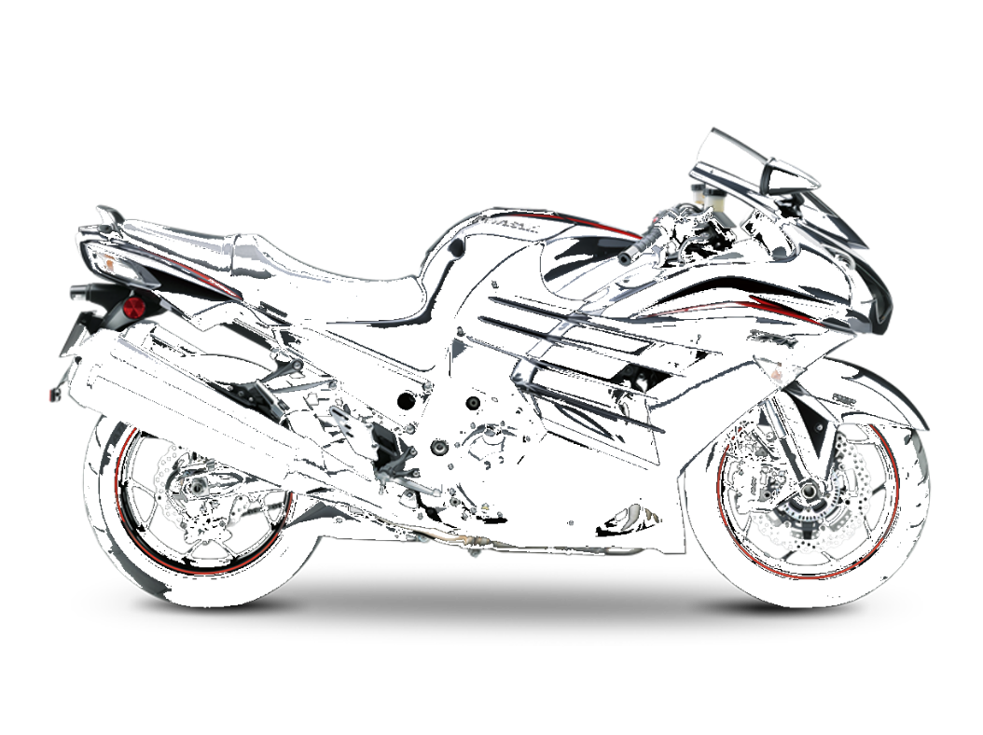
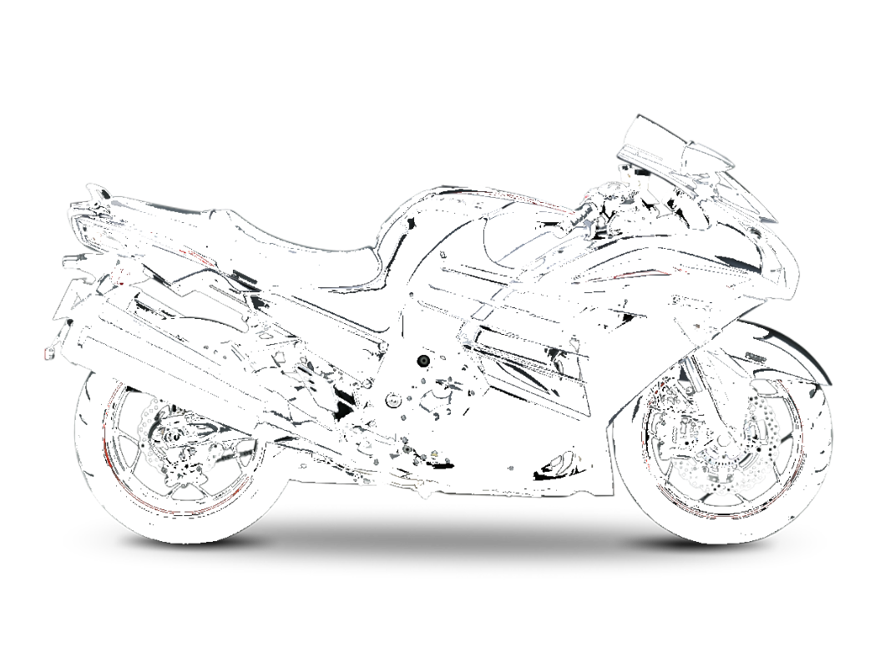
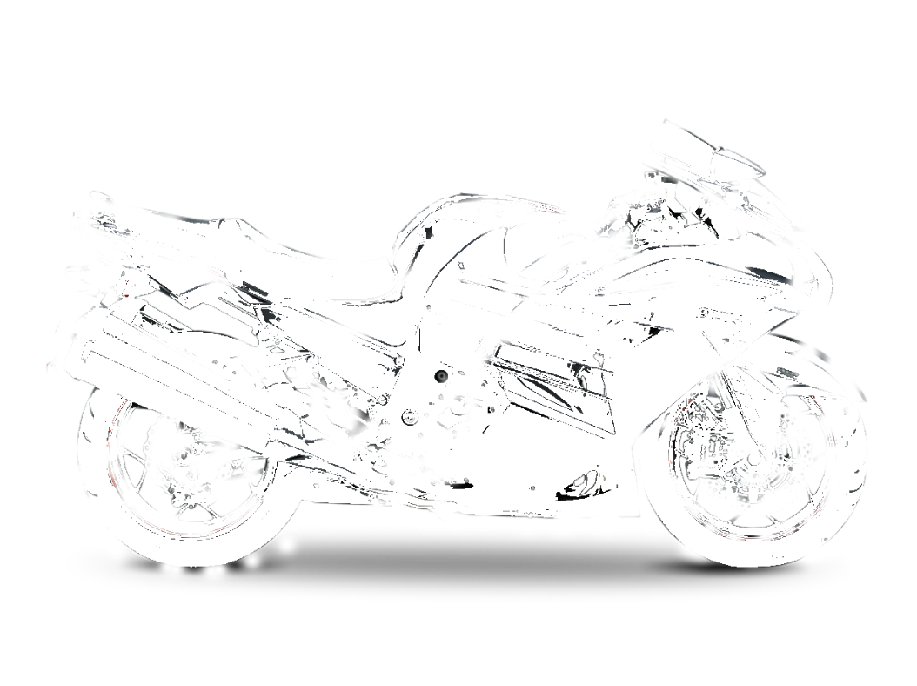
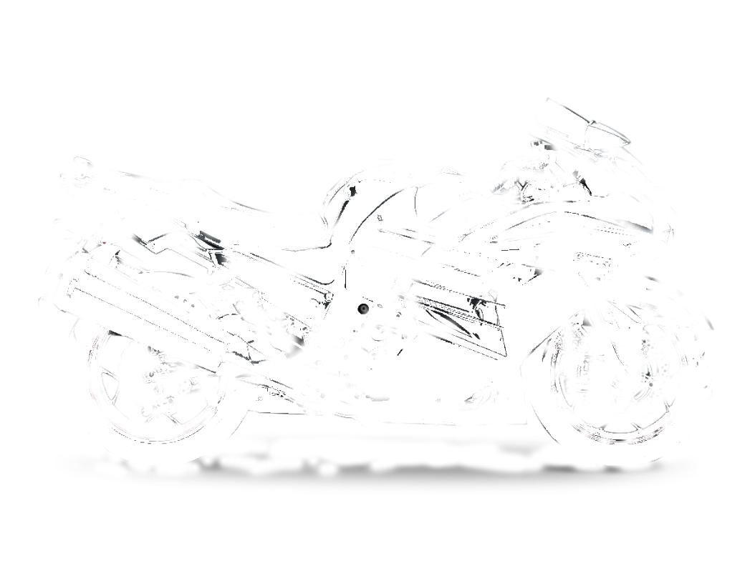

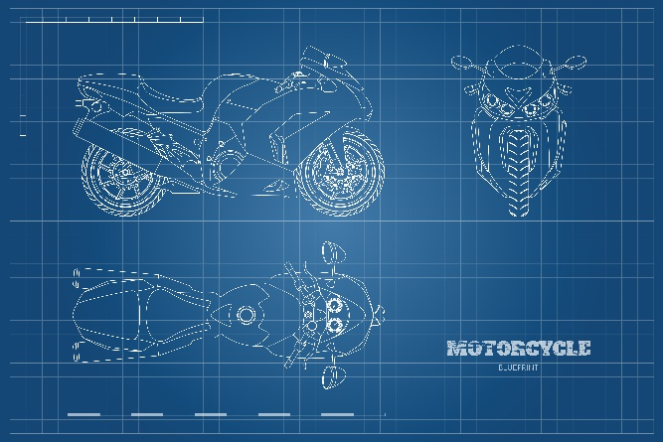
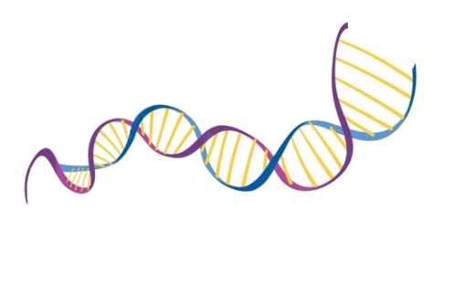
OK … How to make it real?
?
?
Notes:
Same as previous

Slide 16
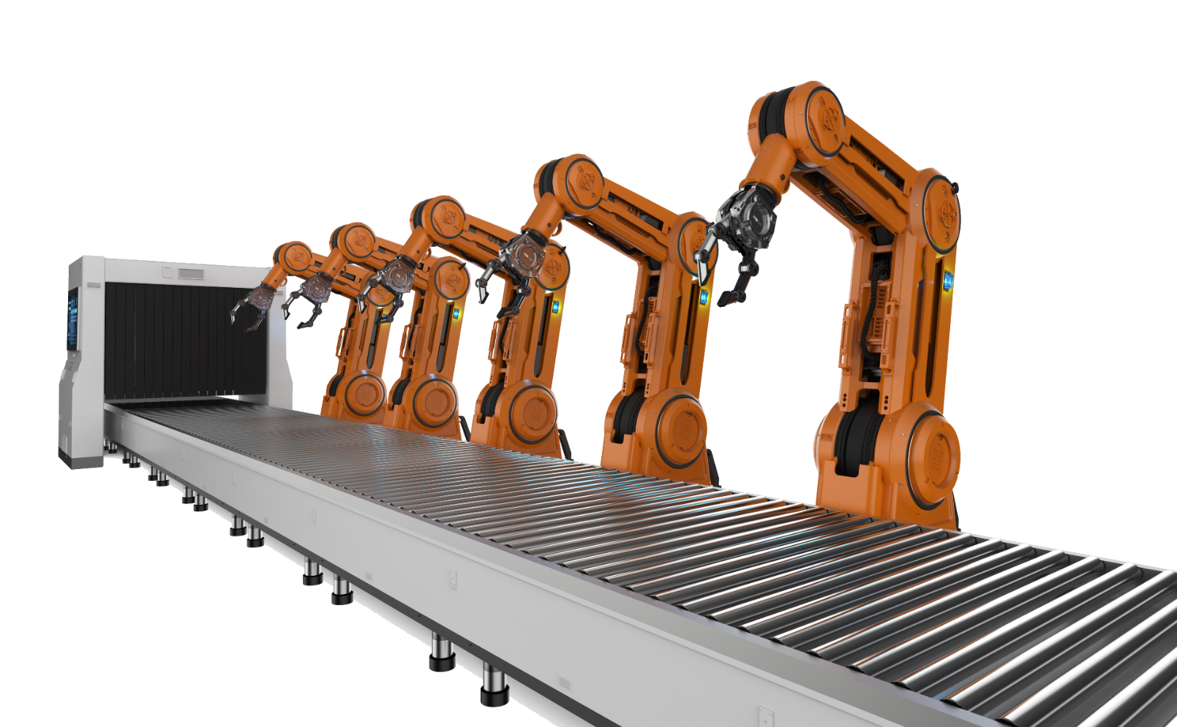


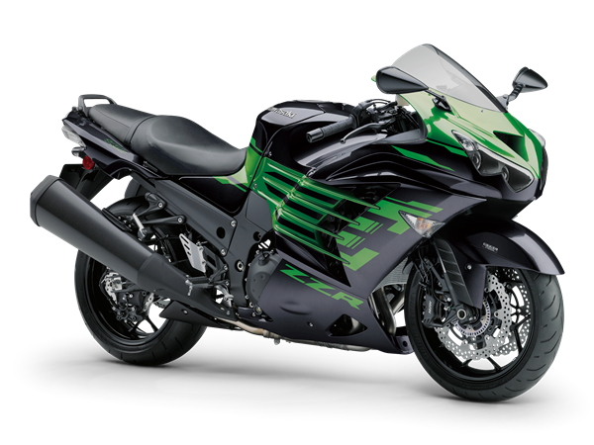
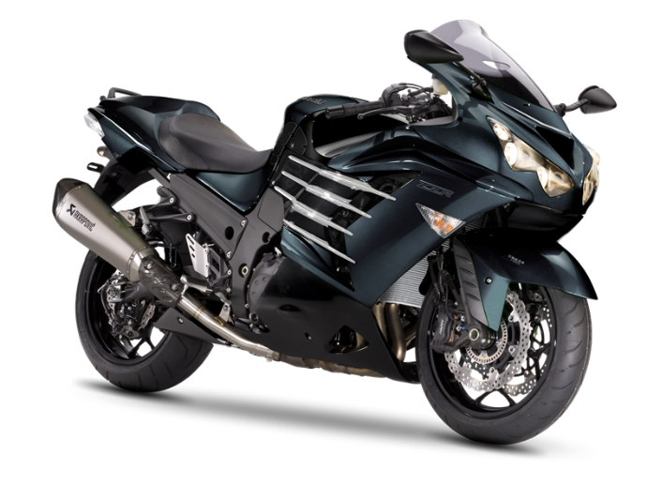
We automate and build a factory of course !

Slide 17




We automate and build a factory of course !
Collaborate. As code.
?
Standard
?
?
?
?
Contribution checklists
?
?
?
?
Designed for collaboration
Asynchronous reviews
Propose
Approve
Merge
Notes:
Proposing to replace the blue line by a purple one (darker) so you can give the same feeling but with same palette of colors / giving you an example – center cercle + 1 arrow – you can revert
Not fan of lines on boxes if color helps you delimite the space.. I have changed only on this slide so you can compare and decide
Bullets on the right part are not moving..is it iin purpose the they are always fixed? No interacting with the other part of the slide? Eyes of the attendee are usually following what is moving.
Maybe try a little bit more of transparency

Slide 18

Jenkins. To automate checks.
Standard
Trigger hooks
Versatile
Ease feedback loop
Automation avoids mistakes
Notes:
same comment as before
Use same palette of colors for shapes OR you can create depth with ligher colors or removing lines .. But depends on the effect you want to give
I gave you an example on the big circle, how it looks if you remove the line
Remove the separator gray line since color is naturally delimitating the space

Slide 19





Automatic checkpoints
Error checks
Security checks
Operational checks
Freeze
Audit trail
Gatekeeping
Replacement for prod boards
Notes:
Same as before

Slide 20

Apply the declarative model
Standard
Leverages the declarative model
Compares model and reality
Notes:
Same as before

Slide 21


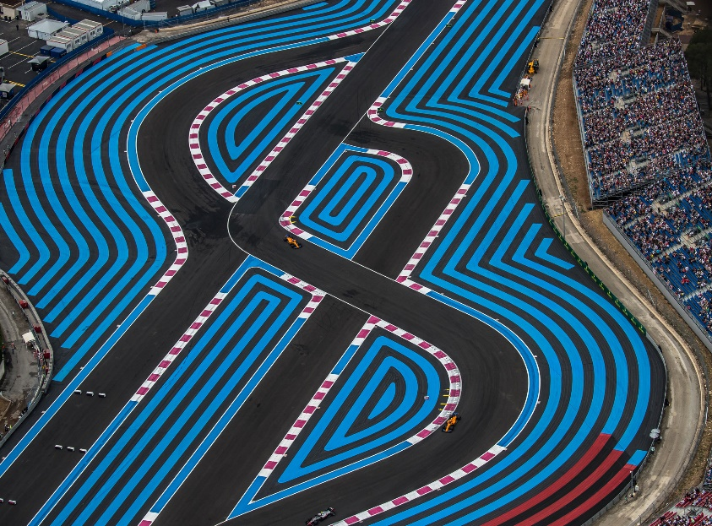
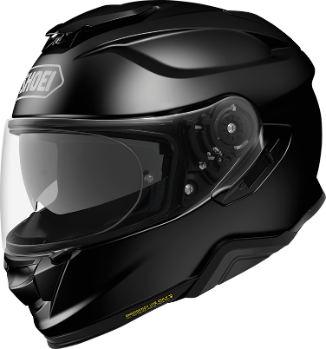
4- Deployments
Automatic checkpoints
Factory. Of Anything.
Infrastructure
Application
Other
Security
Notes:
Blue lines
Reduced the soft edges

Slide 22
Factory. Of Anything.
Infrastructure
Applications
Security
Anything…
Other
Notes:
Same as before

Slide 23
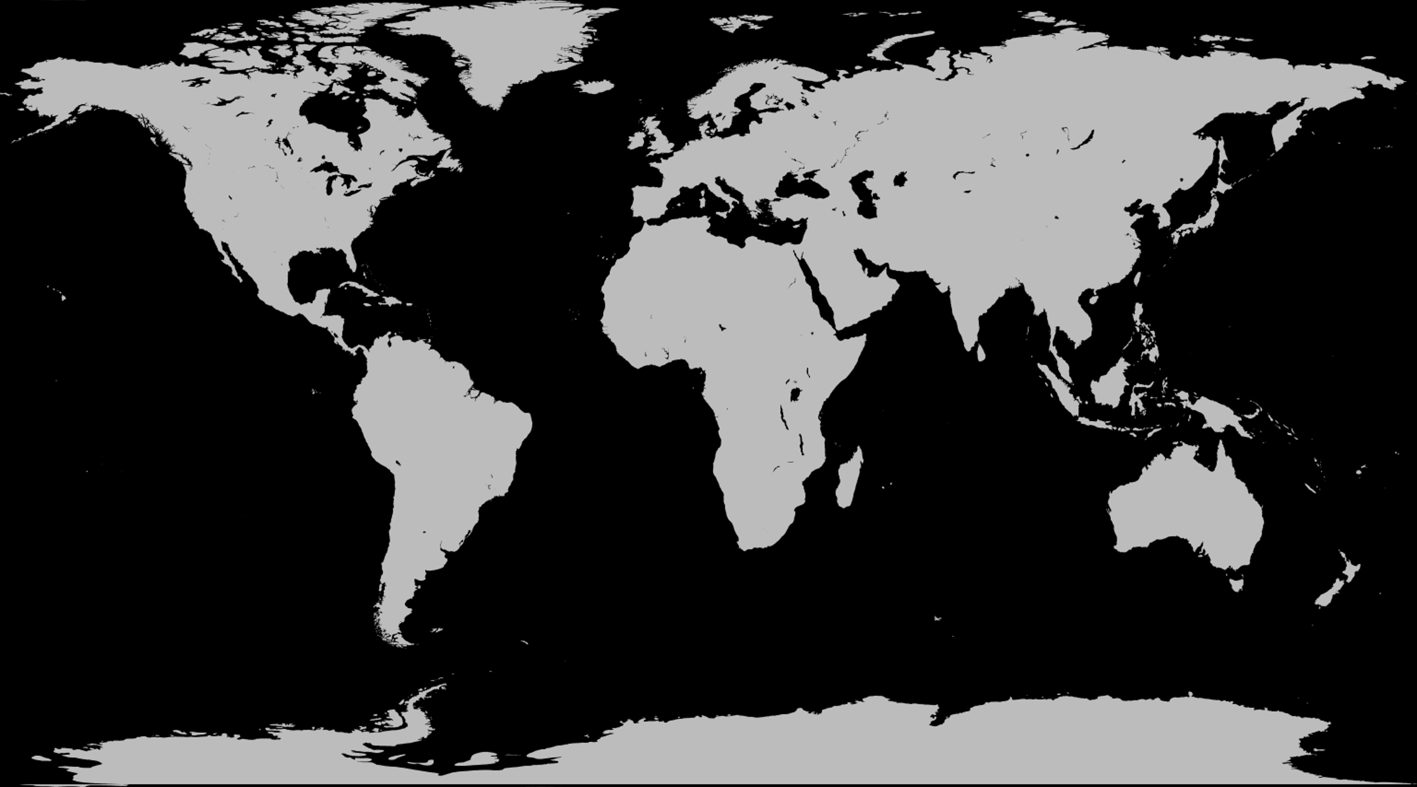
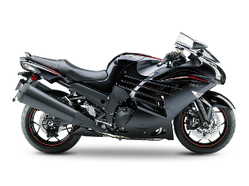
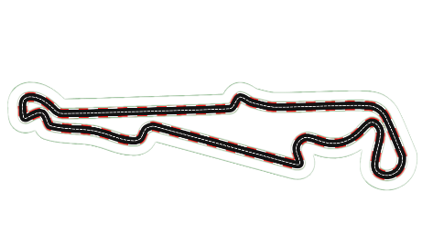
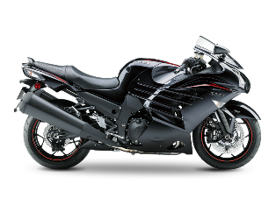
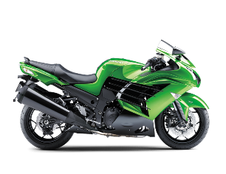

Factory. Of everything.
Other
Notes:
Map is a little extra wide – so looks stretched
Maybe arrows could be a little bit tighter

Slide 24

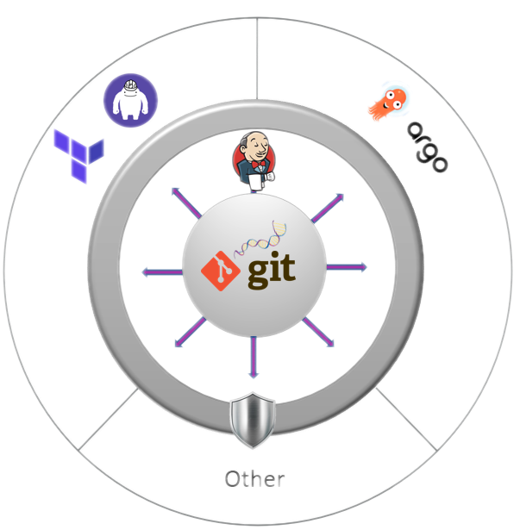

Slide 25
Auditable ?
All changes clear and traceable
Git Blame
Git Diff
Audit trail
Other
Notes:
Same as previous in terms of colors and lines

Slide 26

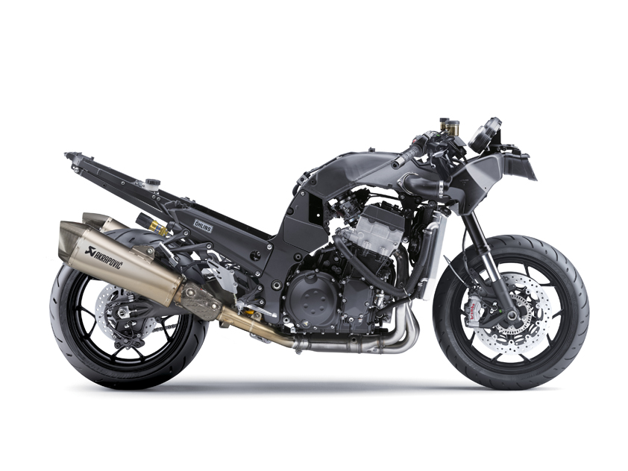
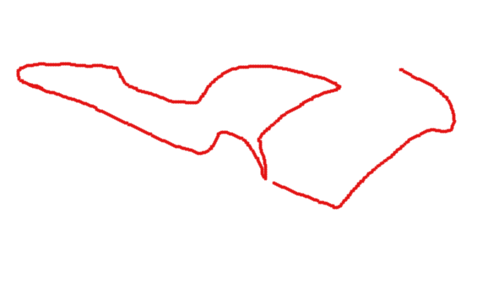
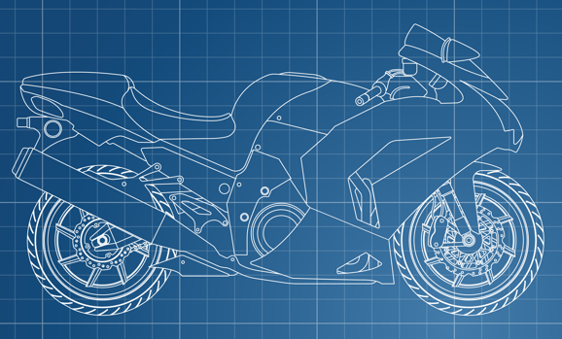
Resilience ?
Easy recovery from a temporary issue
Self healing
Other
Notes:
Same as previous in terms of colors and lines

Slide 27

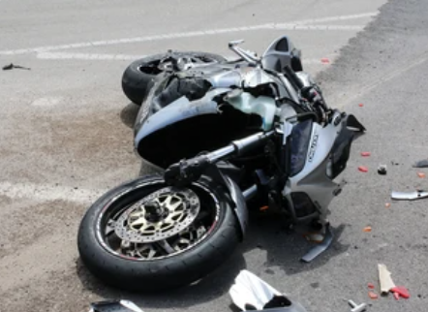
Recoverability ?
Things.
Go.
Wrong.
git revert !
Other
Notes:
Same as previous in terms of colors and lines
Not sure about the git revert with the moto :D

Slide 28







Let’s go GitOps !
Other
RECOVERABLE
RESILIENT
AUDITABLE
SIMPLE
Notes:
Will recommender softer colors and review the blue + purple effect

Slide 29
Time for a live demo !
Let the demo gods be on our side

Slide 30

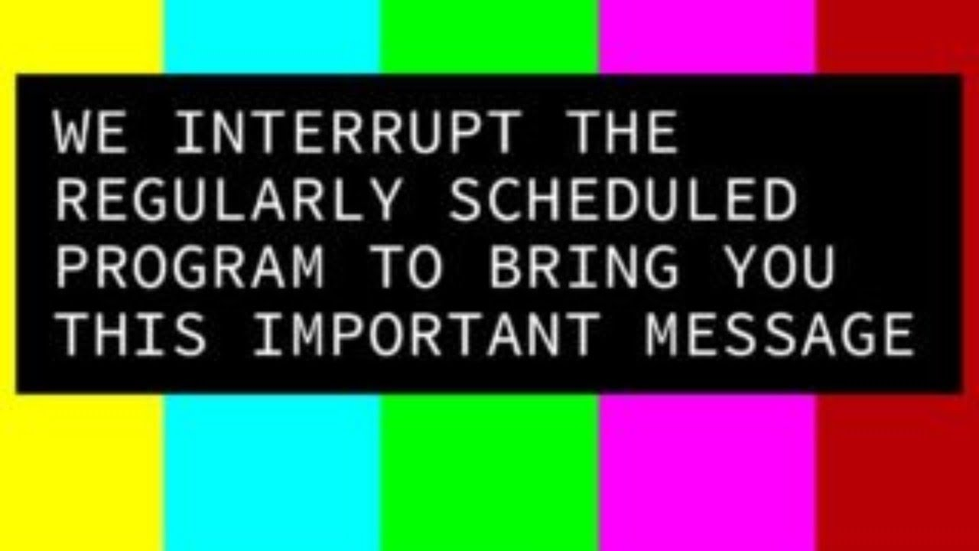
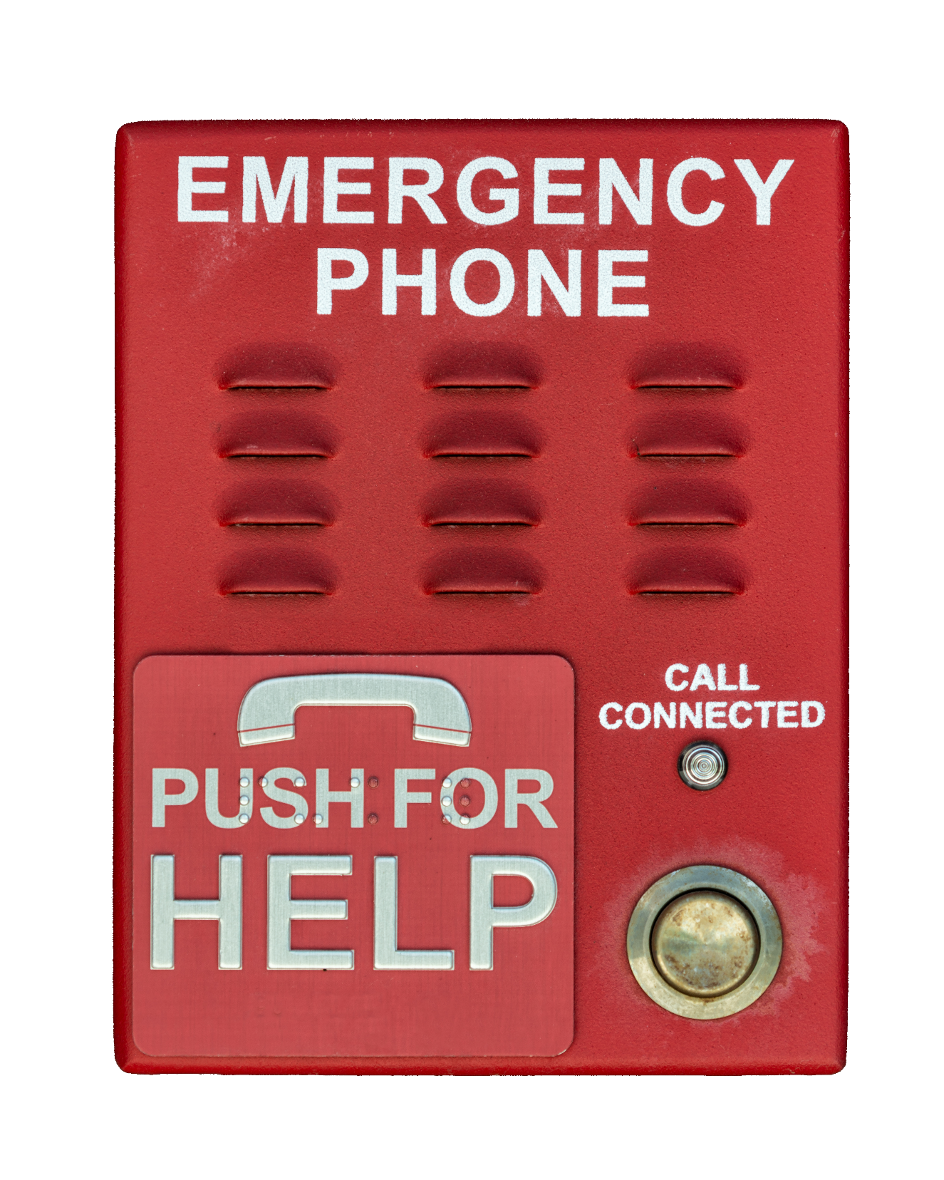
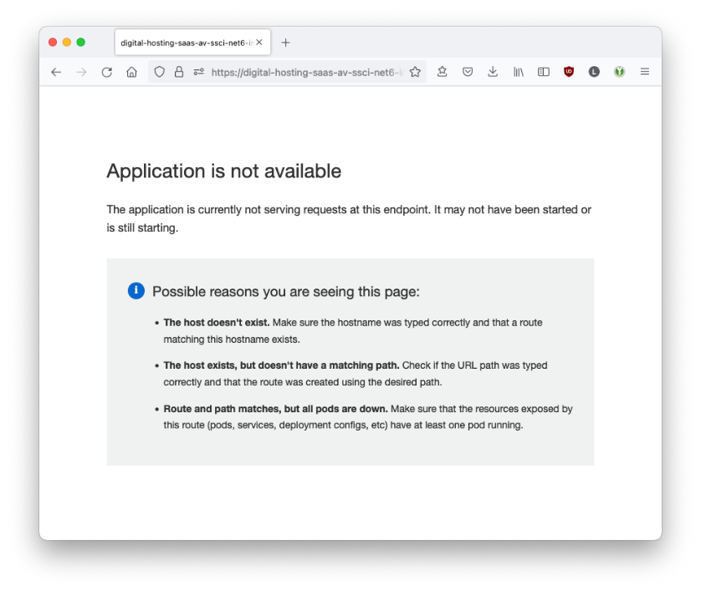
Orlando … We have a problem!
Our production environment is not accessible anymore
We need to migrate to a new region NOW
Notes:
Red is not recommended on slides as for daltonian & disable people – I think your icons are already self explanatory
Boxes with text can be improved with degradation instead of line box
Whatabout Active Active ?
Whatabout SSDR ?

Slide 31

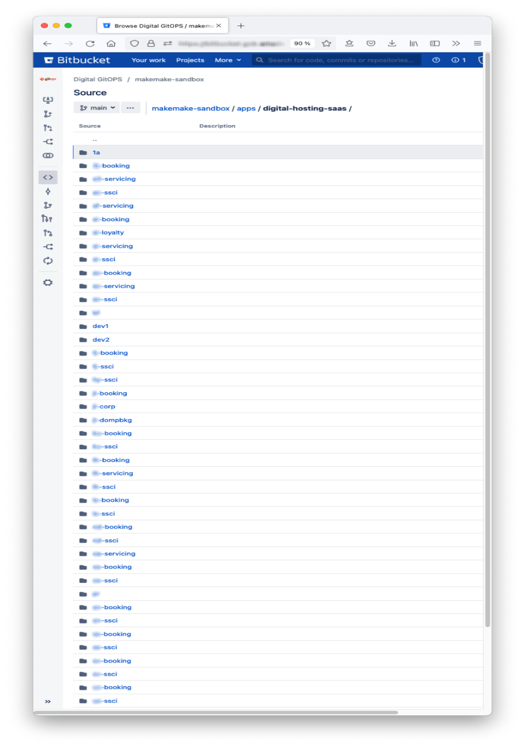
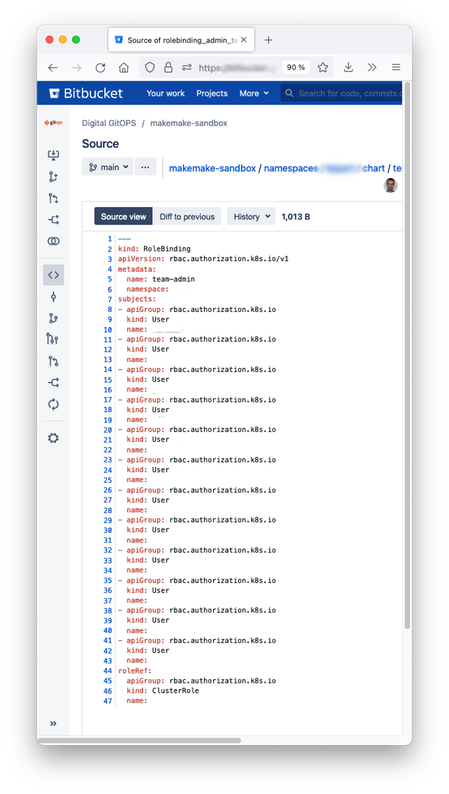
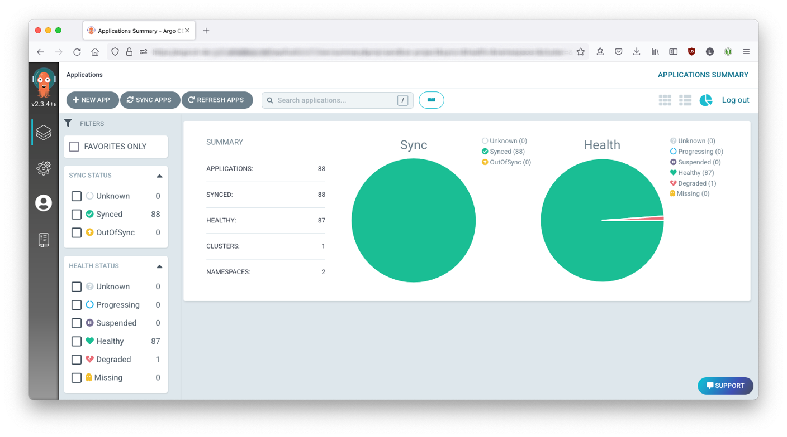
From zero to hero
How to deploy a complete production environment in minutes
Equivalent of a disaster recovery
Benefits of a declarative model
In a few minutes we’ll recreate everything
Deployment of 80 Helm Charts
Permissions
Routing / Network rules
Certificates / Secrets
...
With proper operational controls !!

Slide 32
Key points
What did you just witness?

Slide 33
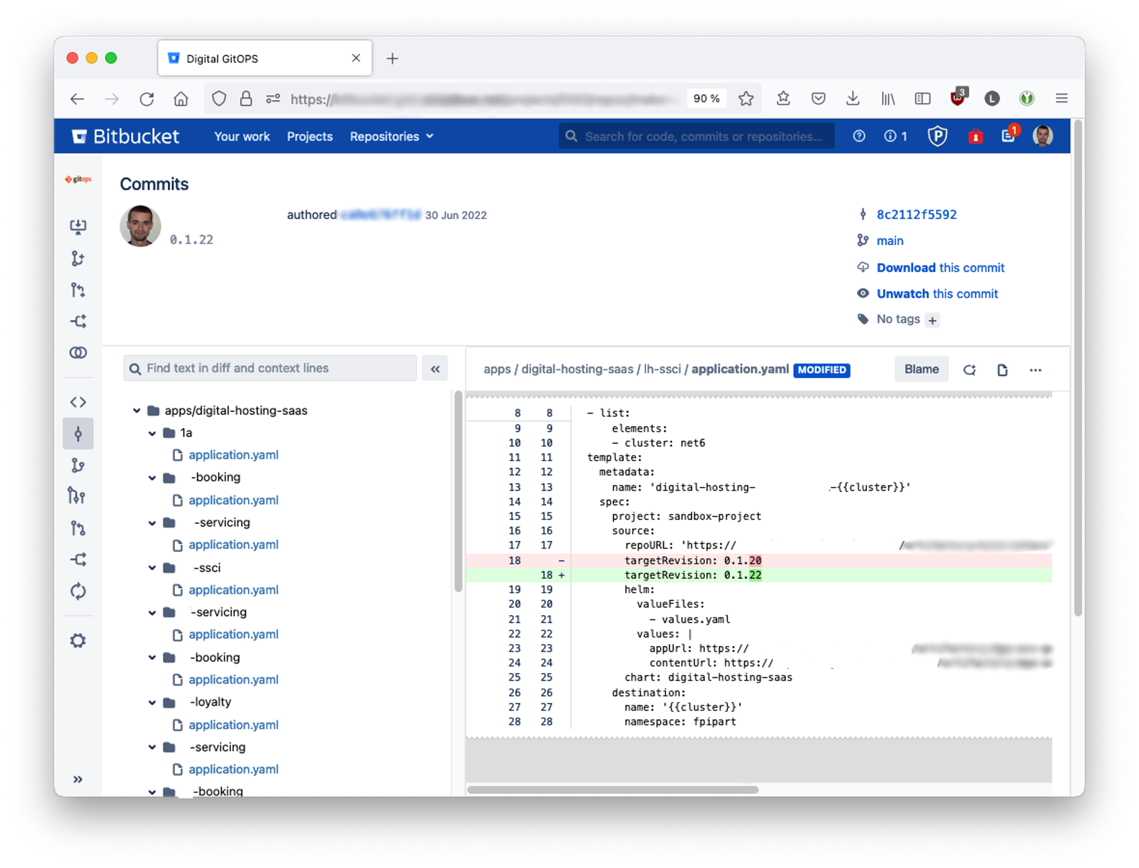
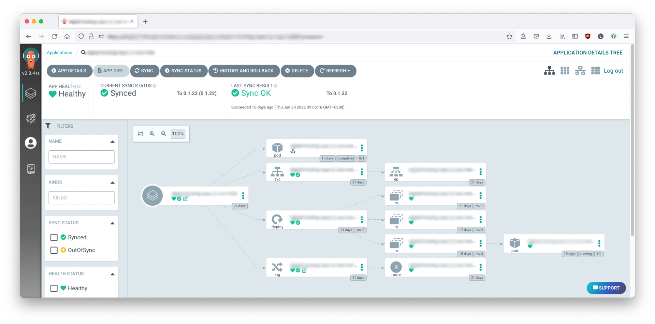
DevOps with GitOps
Look how easy it is to request the load of a new version
Operations (and their processes) as code
Try again
Dev does a Pull Request with all necessary information
Error
detected
Static sanity checks and Helpers for reviewers
Refused
Review / Approval by Ops (in BiBucket or via Control Board)
Merge
Log change for traceability
Refused
Last minute gatekeeping (load window, freeze)
Fallback always ready
Load failure
Argo CD applies the change
Notes:
When slides are heavy in images, I am not sure the mountains layout fits – up to you
Are you planning to have animations in your diagram flow?

Slide 34
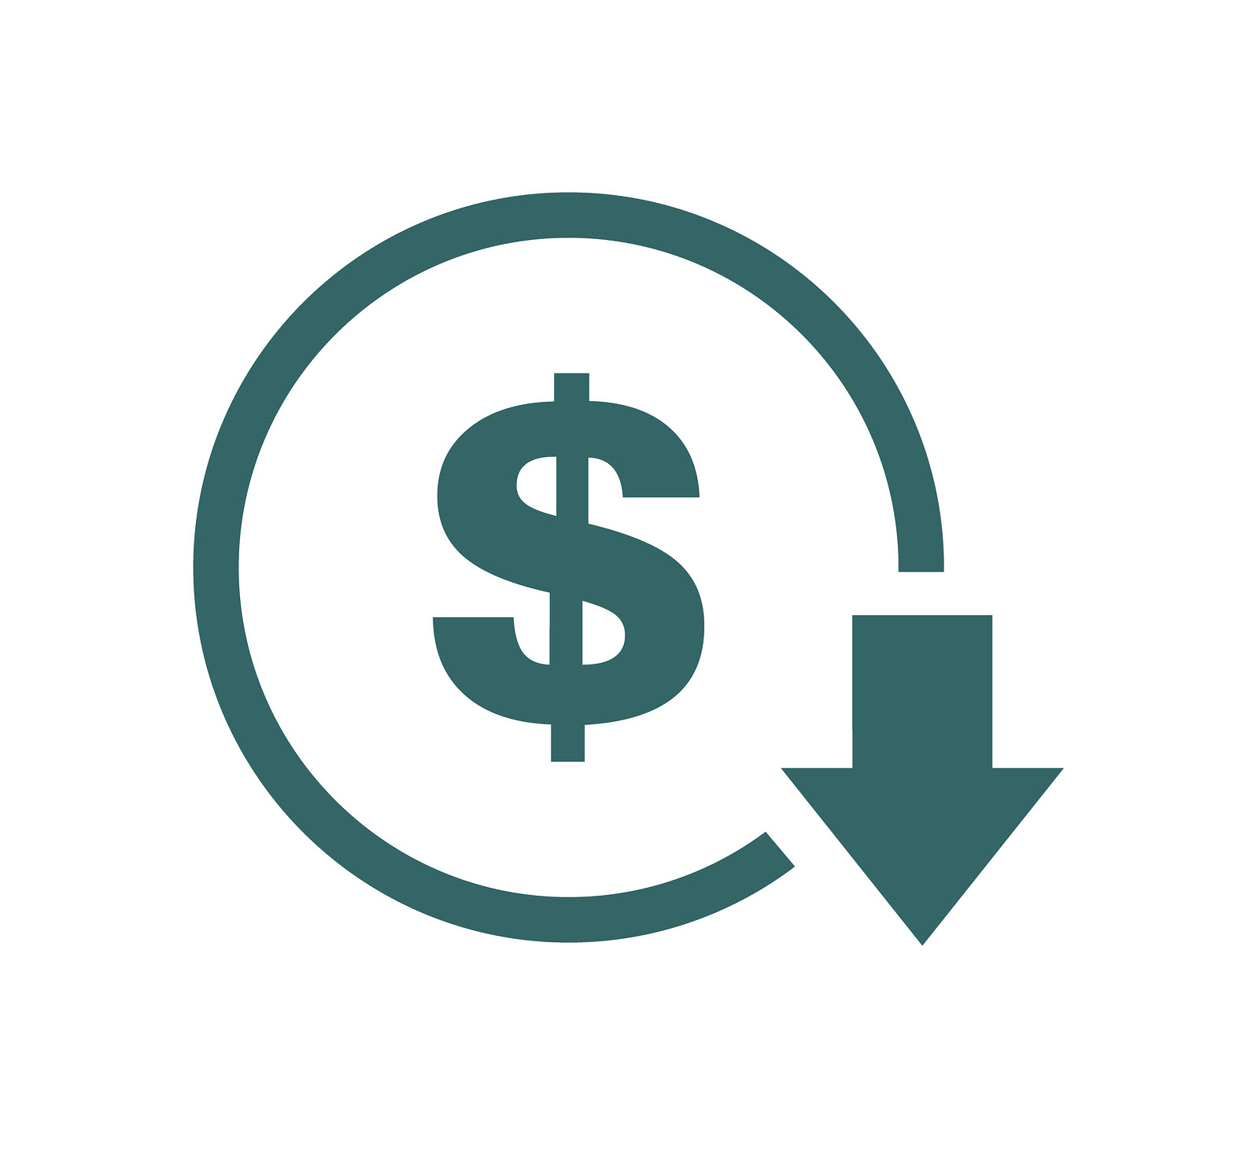
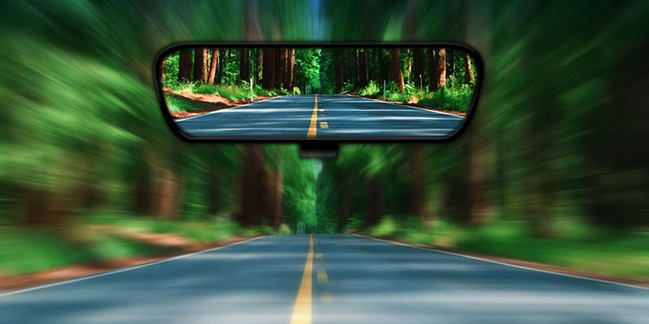




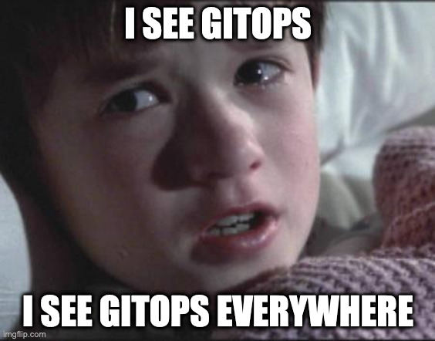


This was just an illustration !
What you saw really happened to us (in test environment)
GitOps is great
Our feedback looking back at our journey
Takeaways
A disaster recovery is hard to implement
All in GitOps not just a part
Adoption is key
Self Healing is great
GitOps
Security at the top of its game
Setup tighter control on toolchain
Maintain toolchain updated
Special attention for secrets automation
What else?
Everything as Code: network, permissions, secrets, conf …
Canary loads

Slide 35
Question ?

Slide 36



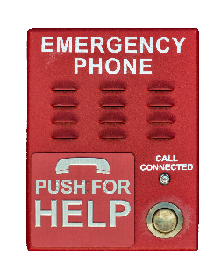
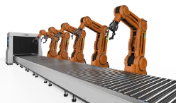
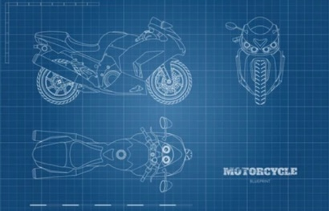






Image Bank & License
Amadeus from Adobe Stock
Amadeus from shutterstock
Common creative License (https://freesvg.org/)
Public concealed

Slide 37






Our global operations
World’s largest data processing center dedicated to the travel industry
Over 100,000 transactions per second at peak
Data center with 24/7 support across the globe
Scalable technology built on service-oriented architecture
9/25/2022
Notes:
Out from overall template – some reason? Why not using the white layout like the others?

Slide 38

Security key points
Our feedback looking back at our journey
Access governance
Secure your delivery
Secured Login Permission management
Audit Trail
Automate your secret « rekey »
Dependencies control
Treat your CI/CD chain as it is : an administration product
Notes:
I would maybe suggest maybe using some boxes or shapes will give a little highlight?

Slide 39




Good, I understand it will require collaboration between the two of us
OK but during those hours of board meetings, we also checked a lot of things!
No, that’s great, all the tools weuse are standard, wel supported and state of the art
I need a recap. You told me GitOps will help us embrace DevOps. But can you explain how GitOps expected to work ?
And finally someone merges the PR when relevant. And change gets applied automatically
We used to have the boards meetings. What do they become?
You ll see. BB or GH is great for collaboration, asynch and efficient
Now all the checks will be automated. Just like in dev, your change will trigger a Jenkins build and we coded that it does all the checks. It should save you from a lot of mistakes
Automation is great, but do you plan again to develop everything in-house and I’ll have to chase you for fixes?
Quite simple really. First a Dev a QA or a Release Manager starts a PR with what he wants to change
Then an operator approves or rejects that change after a review
That’s what really helps becoming more DevOps: we need to talk to each other. That is what is great with GitOps. The repo describes exactly how we want everything to be. That’s the contract.
Propose
PR
Approve
Merge
DevOps
Add.
Info
Auto
Checks
Jenkins
Std
2022
Tools
ArgoCD
BASELINE
Let me step back a bit. I want to check that all I need will also be there with GitOps.
Let me think about a few examples.
DEVOPS
Tools
Also usually it works fine in normal cases but bad when something goes wrong. Do I call you each time there is network issue or instability?
No, that’s a pull mode that has great advantages to recover in case of problem.
Even if someone tries to change something manually. Argo will realign
Sounds nice. But there must be a catch. You will stress me and want to load more frequently.
Actually my goal is to stress you less in order to load more often. With more automation, there will be less mistakes !
Everything is as code. So we can review the process together and you can approve it once for all
Sure! Everything is declarative. All you need to do is describe what you want deployed where!
You want to load a new version? Change the source.
You want to migrate from one region to another? Just change the destination. Need to deply a new customer? Duplicate the descriptor file.
Then Argo takes over. It is all built in with Argo. All it does is compare git and prod.
Do we know who did the original request for the change ?
Sure! BitBucket does that just fine. You will love the Blame button
Let’s start with all those loads you ask me. Will they be simple ?
What if it DOES go wrong??? And it will you know !
Don’t worry, of course there are rollback and fallback mechanisms. You ll have the big red button you can push
Self
Heal
Frequent
Less
mistakes
Fallback
Rollback
git
revert
Repeat
Git
Source
Truth
Traceable
GAINS

